Slide 1
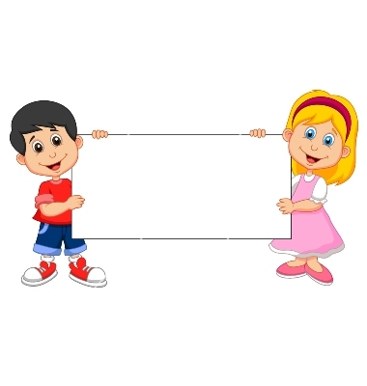
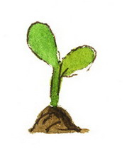
Donation
(Unwilling Plant)

Slide 2
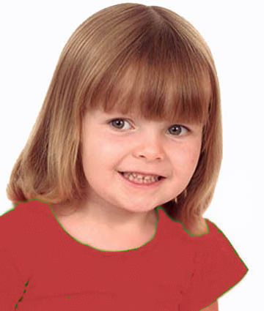
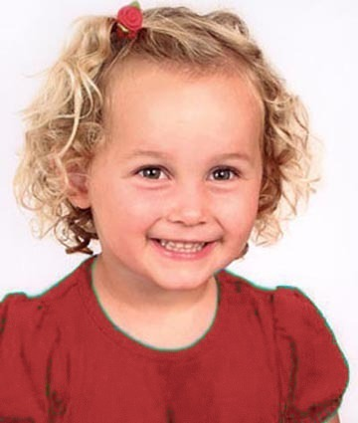
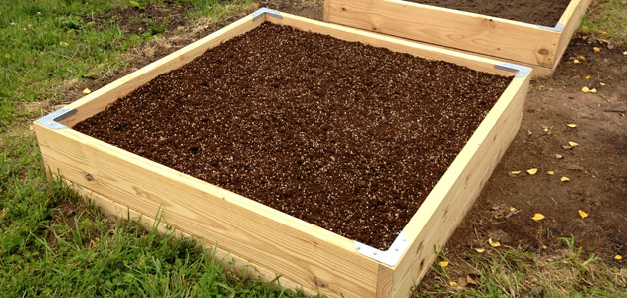
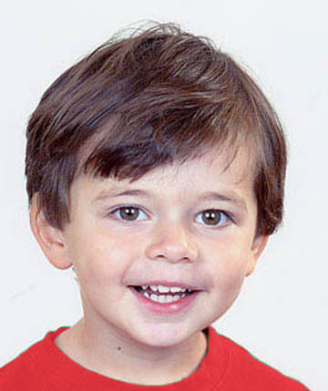
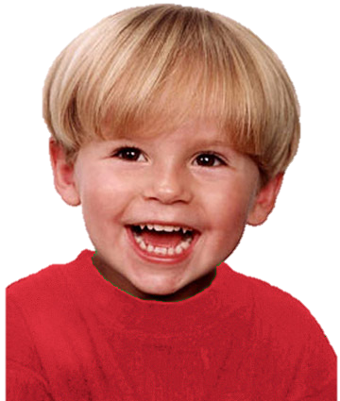
Introduce the group & the garden

Slide 3
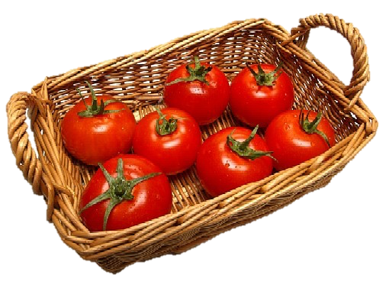
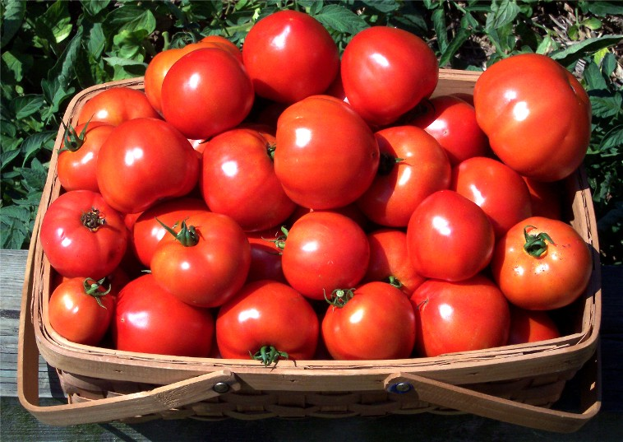
Explain how the garden works

Slide 4
Questions & Feedback

Slide 5
Test Task

Slide 6
The group goal: have a big basket of tomatoes and share them

Slide 7
She doesn’t want to put her plant in the garden. So she plants hers at home (click for animation). The other kids put theirs in the garden (click for animation).
Notes:
The boy (on the upper right corner) wants to put his plant in the group garden,
but a rabbit comes to eat his plant

Slide 8
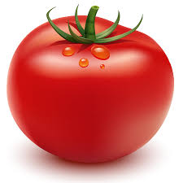
The outcome: They get a small basket of tomatoes. Each kid gets a tomato.

Slide 9
Test Questions
F
C

Slide 10
Test Questions
Free-Rider

Slide 11
Contributor Reminder:
Wanted to put her plant in the garden and put it there.

Slide 12

Evaluation: is she good or bad?

Slide 13
Evaluation: a little good/bad or really good/bad?

Slide 14


Preference: Do you like her or you don’t like her?

Slide 15


Preference: do you like her a little or a lot? do you kind of don’t like her or really don’t like her?
To Free-Rider

Slide 16
Unwilling Free-Rider Reminder:
She doesn’t want to put her plant in the garden. So he plants hers at home. The other kids put theirs in the garden.

Slide 17
Evaluation: is she good or bad?

Slide 18
Evaluation: a little good/bad or really good/bad?

Slide 19
Preference: Do you like her or you don’t like her?

Slide 20
Preference: do you like her a little or a lot? do you kind of don’t like her or really don’t like her?
To Contributor

Slide 21

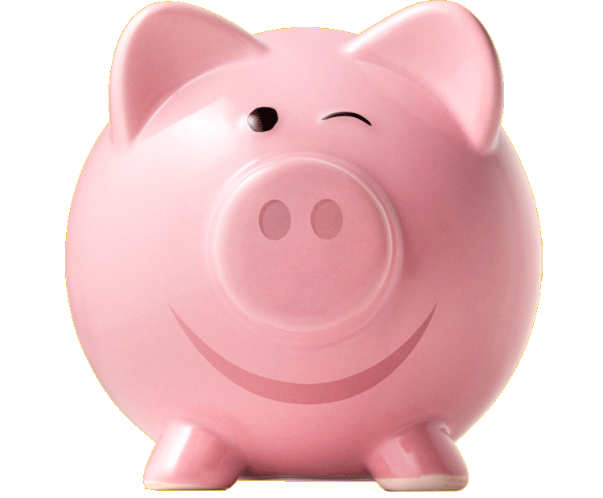
Donation
(Unable Piggybank)

Slide 22
Girls Version
Familiarization Task

Slide 23
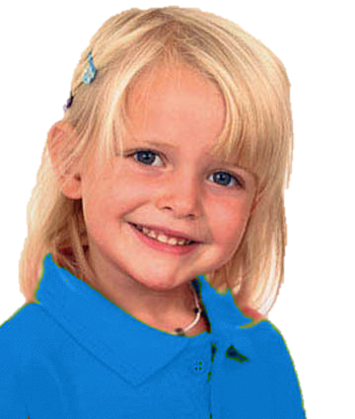
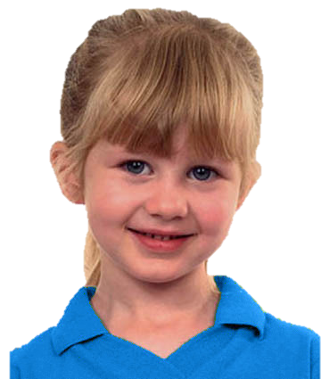
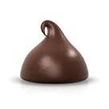
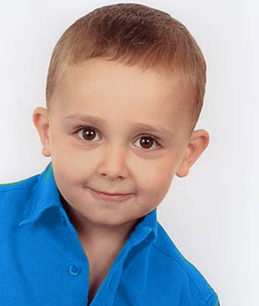
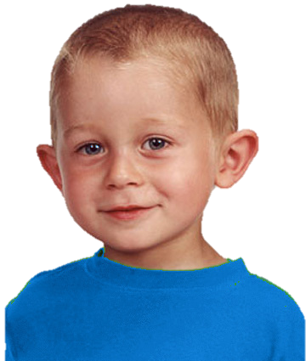
Introduce the group & the piggybank

Slide 24
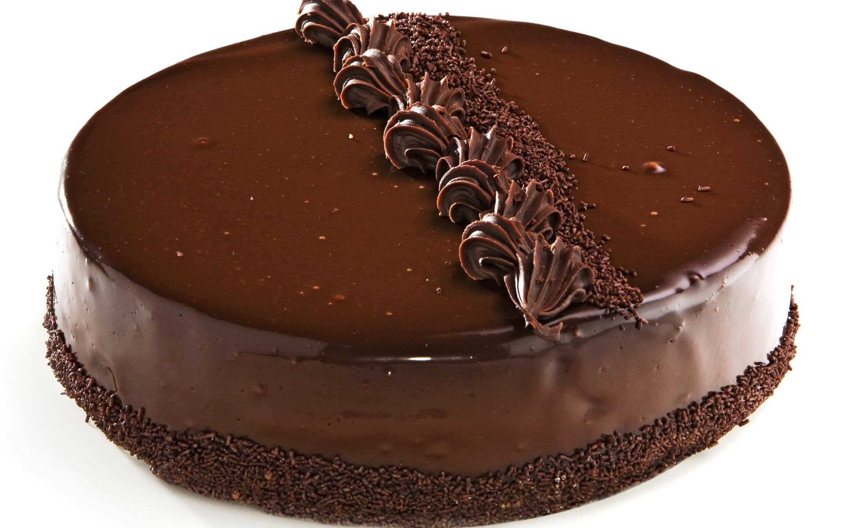
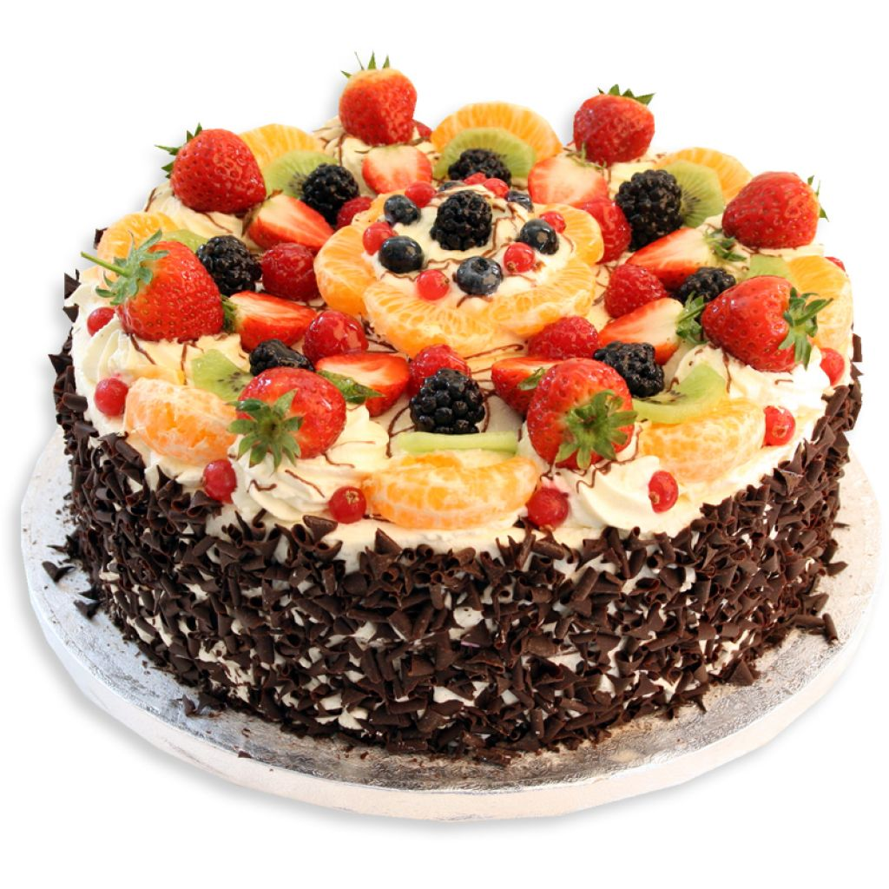
Explain how the piggybank works

Slide 25
Questions & feedback

Slide 26
Test Task

Slide 27
The group goal: have a big cake and share it

Slide 28
Unable free-rider (upper left):
She wants to put her chocolate in the piggybank. But a puppy comes and eats her chocolate. The other kids put their chocolate in the piggybank.

Slide 29
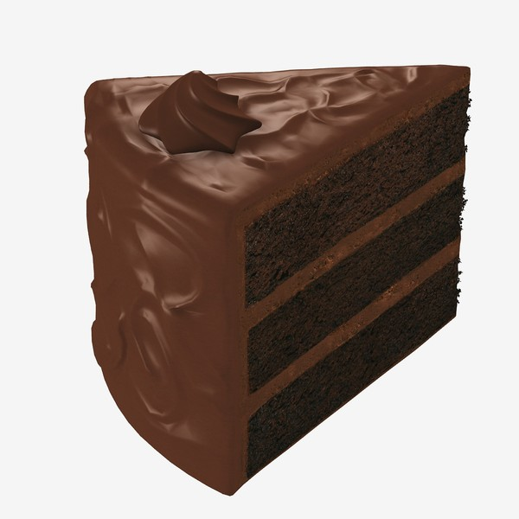
The outcome
The outcome: The piggy bank makes a small cake. Each kid gets a piece of it.

Slide 30
Test Questions
F
C

Slide 31
Contributor Reminder:
Wanted to put her chocolate into the piggybank and put it there.

Slide 32
Evaluation: is she good or bad?

Slide 33
Evaluation: a little good/bad or really good/bad?

Slide 34
Preference: Do you like her or you don’t like her?

Slide 35
Preference: do you like her a little or a lot? do you kind of don’t like her or really don’t like her?
To Free-Rider

Slide 36
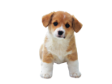
Unable Free-Rider Reminder:
She wanted to put her chocolate in the piggybank. But a puppy came and ate her chocolate. The other kids put their chocolate in the piggybank.

Slide 37
Evaluation: is she good or bad?

Slide 38
Evaluation: a little good/bad or really good/bad?

Slide 39
Preference: Do you like her or you don’t like her?

Slide 40
Preference: do you like her a little or a lot? do you kind of don’t like her or really don’t like her?
To Contributor

